Slide 1
目录
第一部分 软件测试基本概念
第二部分 软件测试技术（方法）
第三部分 软件测试过程（内容）
第四部分 软件测试自动化
第五部分 软件测试管理
第六部分 软件维护

Slide 2
第一部分 软件测试基本概念
A crash is when your competitor’s program dies.
When your program dies, it is an “idiosyncrasy”（行为异常）.
1 Software Testing Background
2 The Software Development Process
3 The Realities of Software Testing

Slide 3
1. Software Testing Background
How software bugs impact our lives
What bugs are and why they occur
Who software testers are and what they do

Slide 4
软件缺陷的由来
由“飞蛾扑火”的故事引出软件缺陷
现象：
1947年 哈佛大学制造 由机械式继电器和真空管驱动，有房间那么大，体现了当时技术水平的Mark II计算机。整机运行时，突然停止工作。
原因：
计算机内部的一组继电器的触点之间有一只飞蛾，飞蛾受光和热吸引，飞到了触点上，被高压电击死。
结果：
从此以后，计算机的缺陷发生了，虽然该缺陷被消除了，但是人们却从此认识了它。(BUG)

Slide 5
Infamous Software Error Case Studies
Disney's Lion King, 1994——1995
（兼容性测试）
Intel Pentium Floating-Point Division Bug, 1994
(4195835 / 3145727) * 3145727 - 4195835
（单元测试）
NASA Mars Polar Lander, 1999
（美国航天局火星极地登陆号探测器）
（接口测试）

Slide 6
Infamous Software Error Case Studies
Patriot Missile Defense System, 1991
（爱国者导弹防预系统，可靠性和稳定性测试）
The Y2K (Year 2000) Bug, circa 1974
（需求不明确）
Dangerous Viewing Ahead, 2004
（安全测试）

Slide 7
没有错误的软件世间难求

Slide 8
What Is a Bug?
Defect | Variance
Fault | Failure
Problem | Inconsistency
Error | Feature
Incident | Bug
Anomaly
Product Anomaly Reports (PARs)
Product Incident Reports (PIRs)

Slide 9
Software Bug: A Formal Definition
1. Doesn’t do something it should do. --------功能缺失
Does something it shouldn’t do. --------错误、缺陷
Does something it doesn’t mention. ------功能多余
Doesn‘t do something it doesn’t mention but should. --------- 对隐性需求的把握，同时发现需求的遗漏
It’s difficult to understand, hard to use, slow, or——in the software tester's eyes——will be viewed by the end user as just plain not right. ------用户体验的角度
product specification

Slide 10
Others Definition
Software Fault: A static defect in the software.
Software Error: An incorrect internal state that is the manifestation of some fault.
Software Failure: External, incorrect behavior with respect to the requirements or other description of the expected behavior.
IEEE

Slide 11
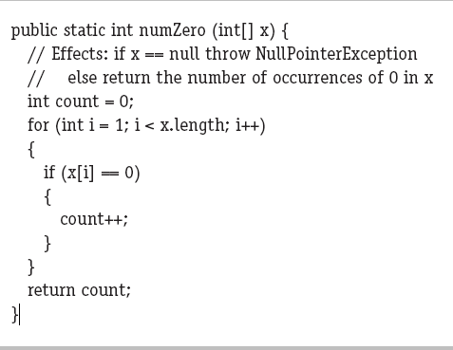
The fault in this program is that it starts looking for zeroes at index 1 instead
of index 0.
Error
( x = [2, 7, 0], count = 0, i = 1, PC = if)
( x = [0, 7, 2], count = 0, i = 1, PC = if).

Slide 12
软件生产中出现问题的不确定性
需求调研
需求分析
产品立项
程序编码
详细设计
总体设计

Slide 13
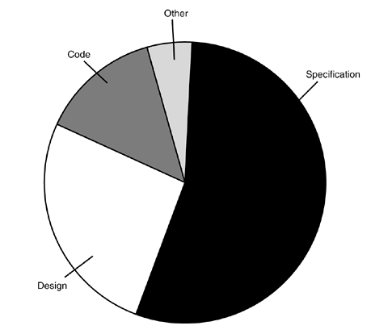
Why Do Bugs Occur?
10%
7%
56%
27%

Slide 14
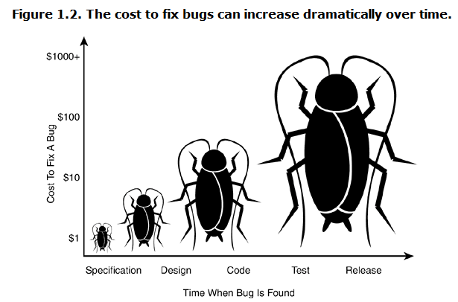
The Cost of Bugs

Slide 15
What Exactly Does a Software Tester Do?
● The goal of a software tester is to find bugs.
● The goal of a software tester is to find bugs and find them as early as possible.
● The goal of a software tester is to find bugs, find them as early as possible, and make sure they get fixed.

Slide 16
What Makes a Good Software Tester?
● relentless （不放弃的;严格的;苛刻的;无情的）
● creative
● good judgment
● tactful and diplomatic
● persuasive（有说服力的）
●software programming
●expert in non-computer field

